Slide 1
Database
Management System
Lecture - 40

Slide 2
Dynamic Views Example
CREATE VIEW st_view1 AS (select stName, stFname, prName from student
WHERE prName = 'MCS')
View can be referred in SQL statements like tables

Slide 3
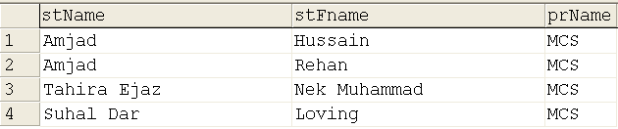
SELECT * FROM st_view1

Slide 4
With Check Option
CREATE VIEW st_view2 AS (select stName, stFname, prName from student
WHERE prName = ‘BCS')
WITH CHECK OPTION

Slide 5
SELECT * FROM ST_VIEW1

Slide 6
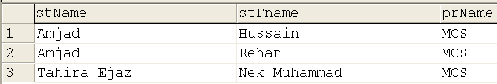
Update ST_VIEW1 set prName = ‘BCS’
Where stFname = ‘Loving’
Select * from ST_VIEW1

Slide 7

SELECT * FROM ST_VIEW2
Update ST_VIEW2 set prName = ‘MCS’
Where stFname = ‘Loving’

Slide 8
Characteristics of Views
Different attribute names
CREATE VIEW st_view3 (name, abbaG, pata) as (select stname, stfname, stadres from student)

Slide 9
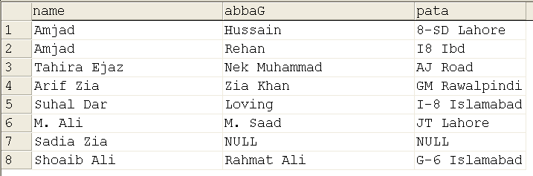
SELECT * FROM ST_VIEW3

Slide 10
Characteristics of Views
Computed attributes
Nesting of views
CREATE VIEW enr_view AS (select * from enroll)
CREATE VIEW enr_view1 as (select stId, crcode, smrks, mterm, smrks + mterm sessional from enr_view)

Slide 11
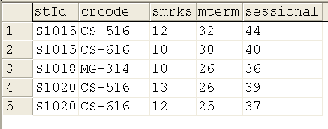
Select * from enr_view1

Slide 12
Data from Multiple Tables
View can include data from multiple tables
Through product, or any form of join
Generally Join

Slide 13
CREATE VIEW st_pr_view AS (select stName, stFname,
student.prName, prcredits
FROM student, program WHERE
student.prname = program.prname)
SELEC * FROM st_pr_view

Slide 14
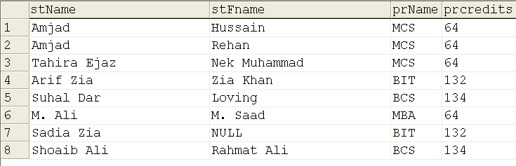

Slide 15
CREATE VIEW st_cr_enr_view1 (a1, a2, a3, a4, a5, a6, a7)
AS (select stName , crname, mterm, smrks, fmrks, mterm+smrks, totmrks, FROM student, course, enroll
WHERE student.stid = enroll.stid and course.crcode = enroll.crcode)

Slide 16
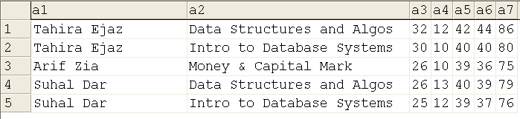
SELECT * FROM st_cr_enr_view1

Slide 17
Updating Data
If single table, updation piece of cake (with check option)
We can even insert data, BUT
  Not through computed attribute
  Cannot miss “Not NULL” attributes
  One of the multiple tables
  Not in case of aggregate functions

Slide 18
CREATE VIEW st_view1 as (SELECT stId, stName, stFname, prName from student where prName = 'MCS’)
INSERT INTO st_view1 values ('S1042', 'Ahmad Ali', 'Ali Hussain', 'BCS')

Slide 19
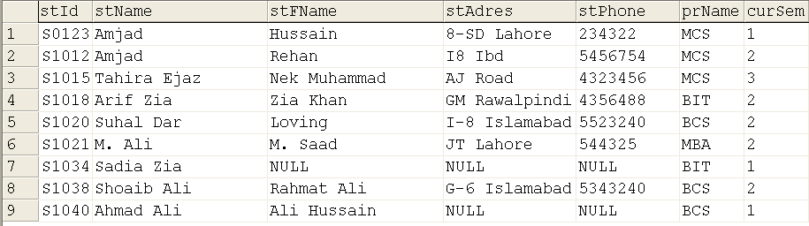

Slide 20
ALTER VIEW st_view1 as (SELECT stId, stName, stFname, prName from student where prName = 'MCS’) WITH CHECK OPTION
INSERT INTO st_view1 values ('S1044', ‘Ali Raza', ‘M. Raza ', 'BCS')

Slide 22
Database
Management System
Lecture - 40

